Slide 1

How to make apple pie
By 6th grade

Slide 2
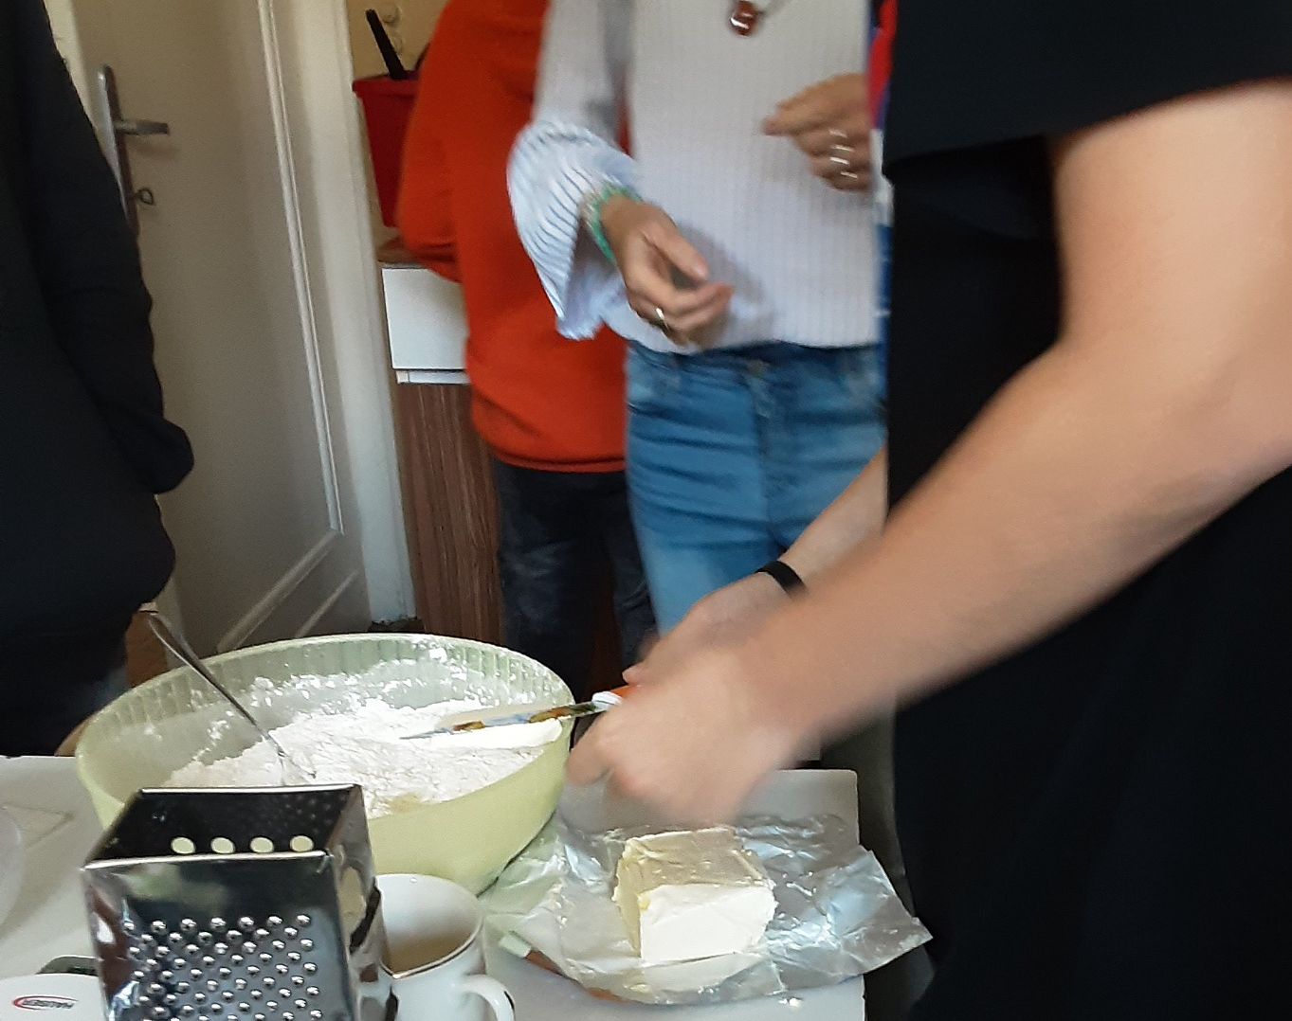
Ingredients
500g smooth flour
160g powdered sugar
250g palmarin
baking powder
two eggs
1vanilla
1 cinnamon sugar
milk
10 apples

Slide 3
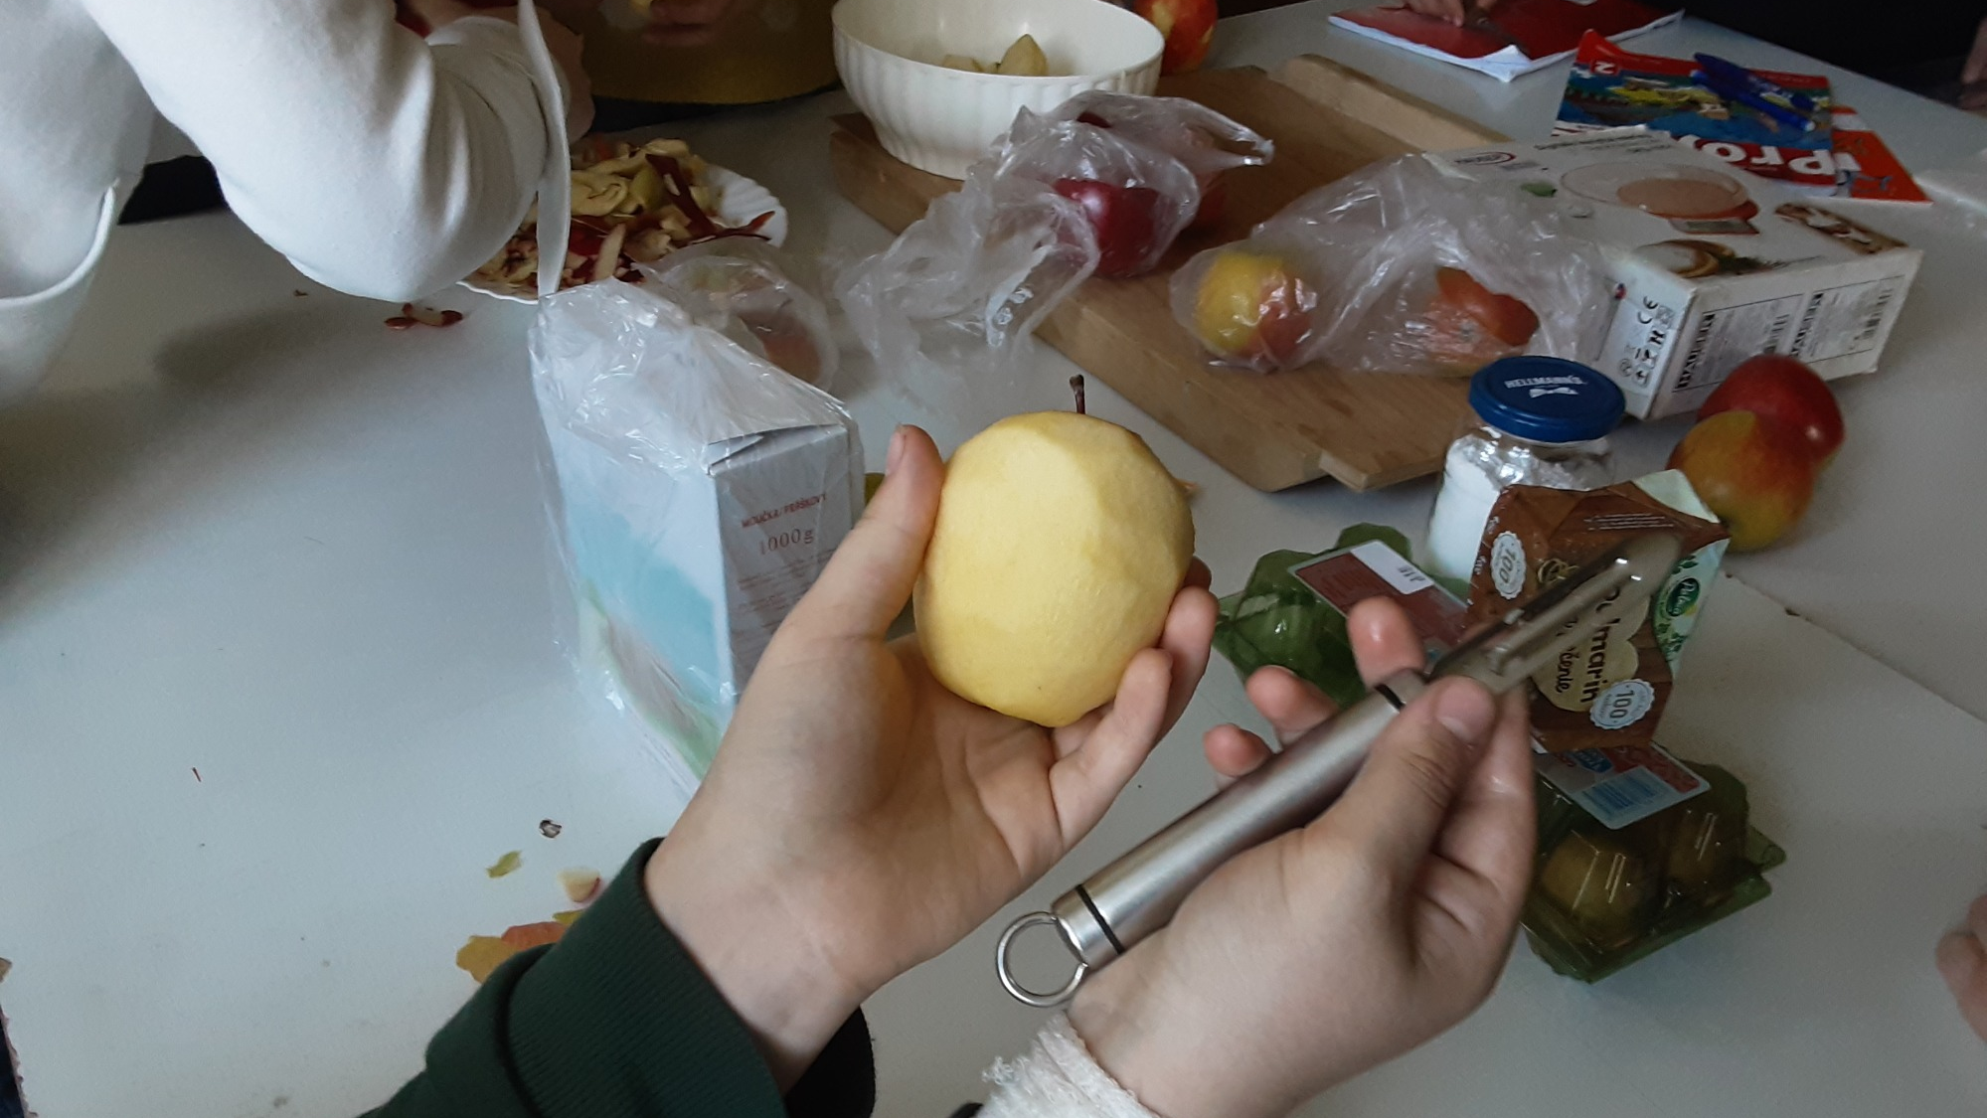
1. we cut and grated the apples

Slide 4
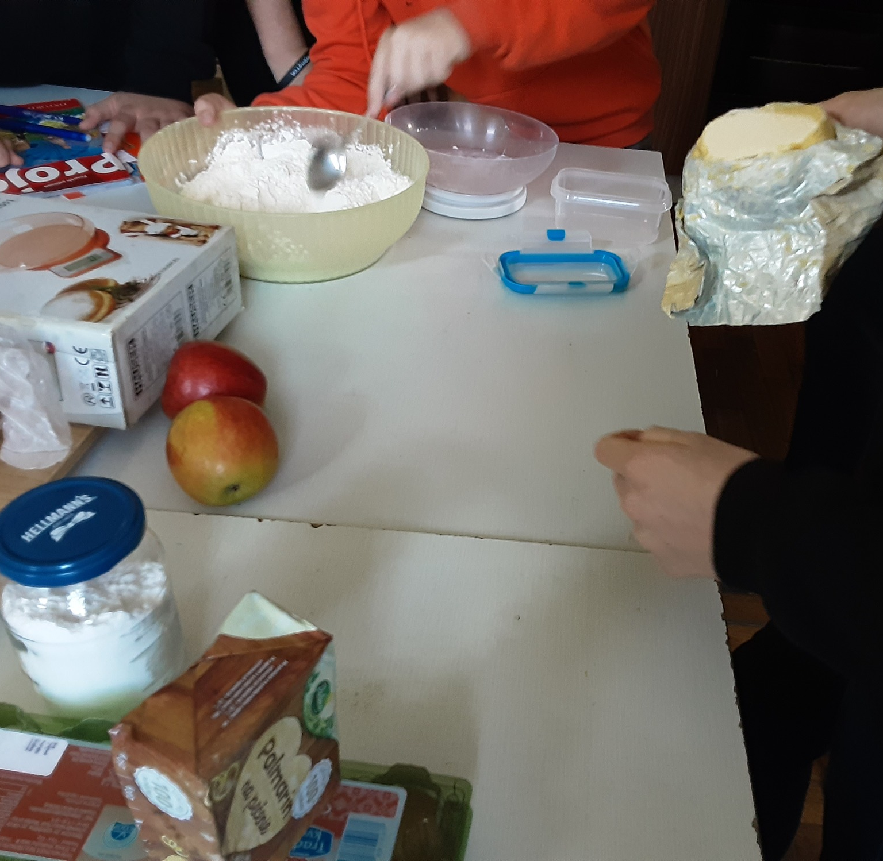
2. we put flour baking powder palmarin and eggs in a bowl

Slide 5
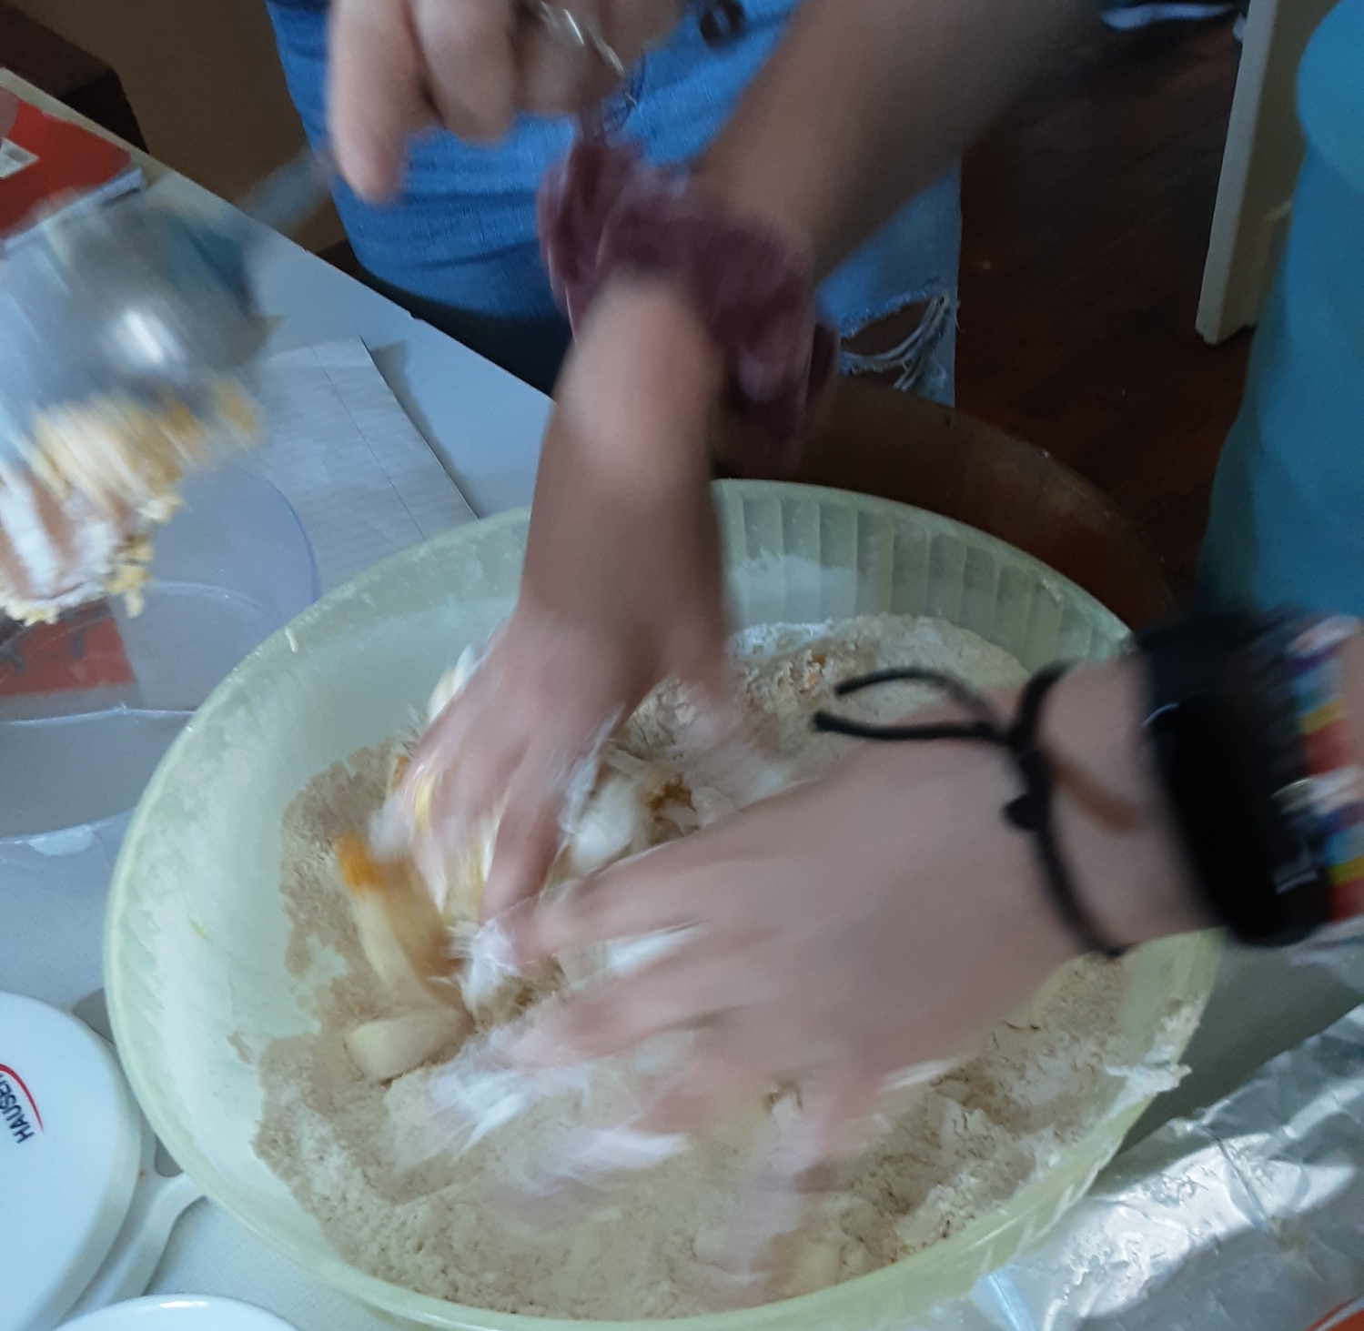
3. then we mixed the dough

Slide 6
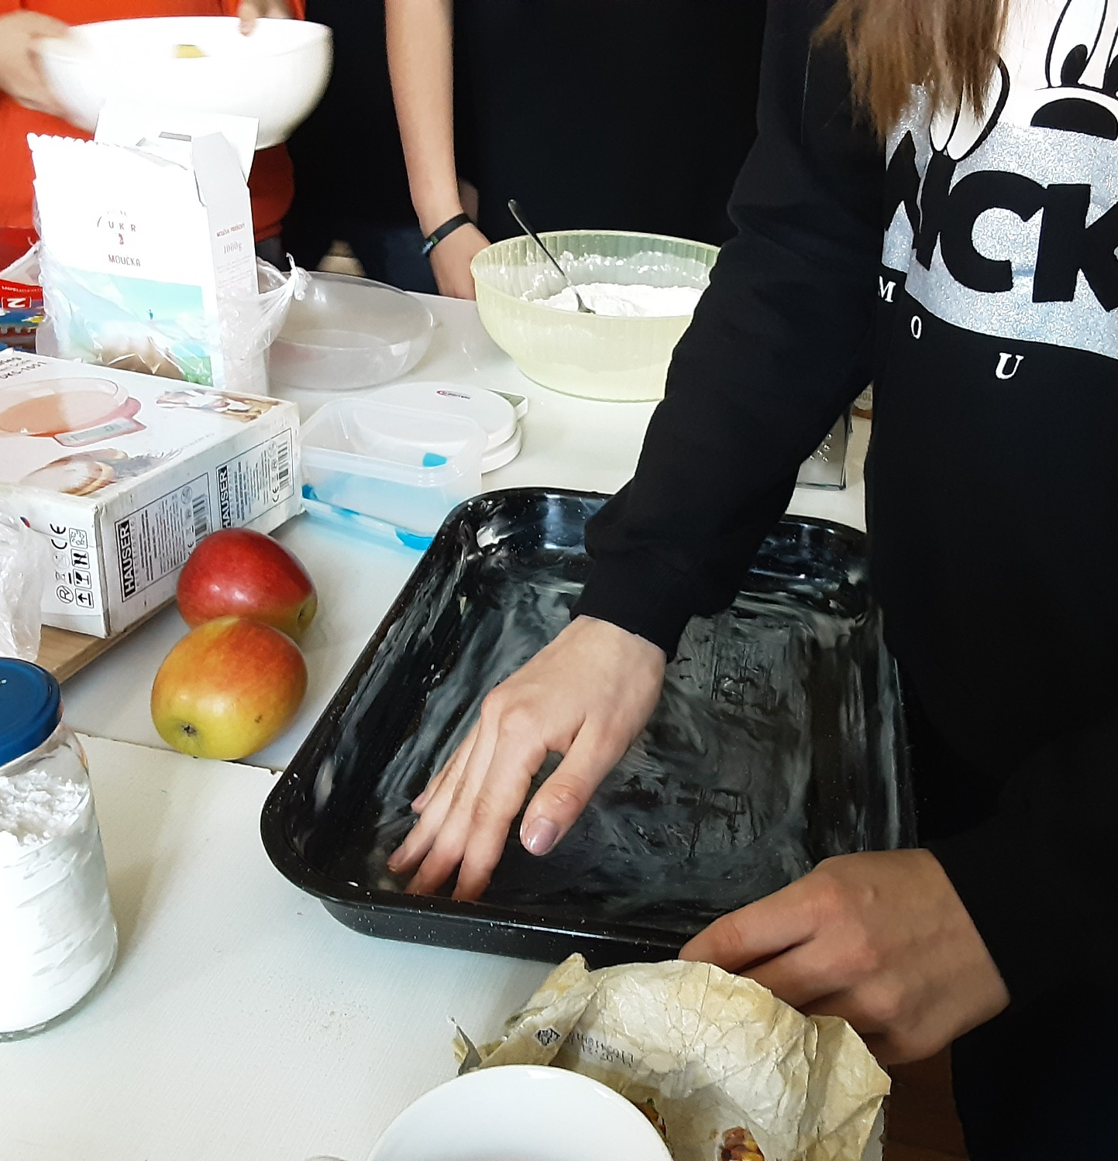
4. we painted the plate with palmarin and then poured flour on it

Slide 7
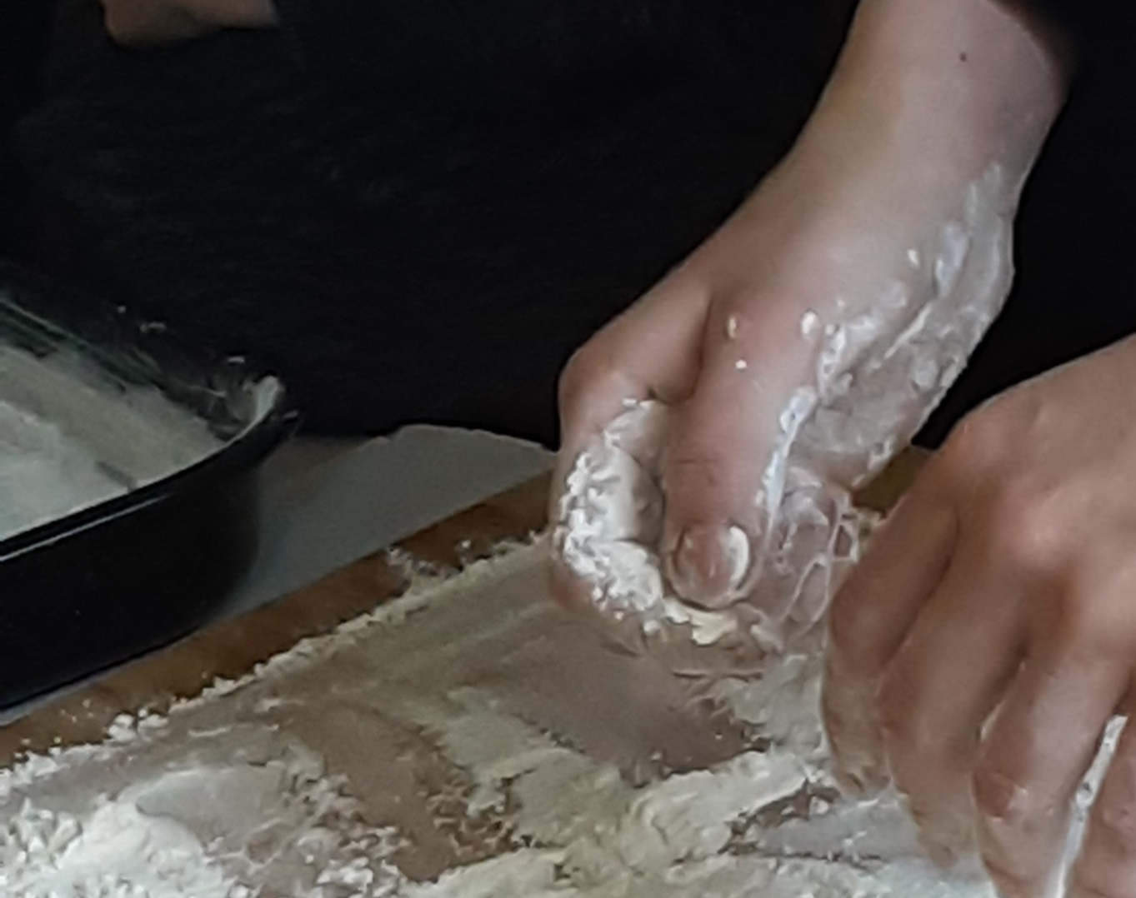
5. roll the dough

Slide 8
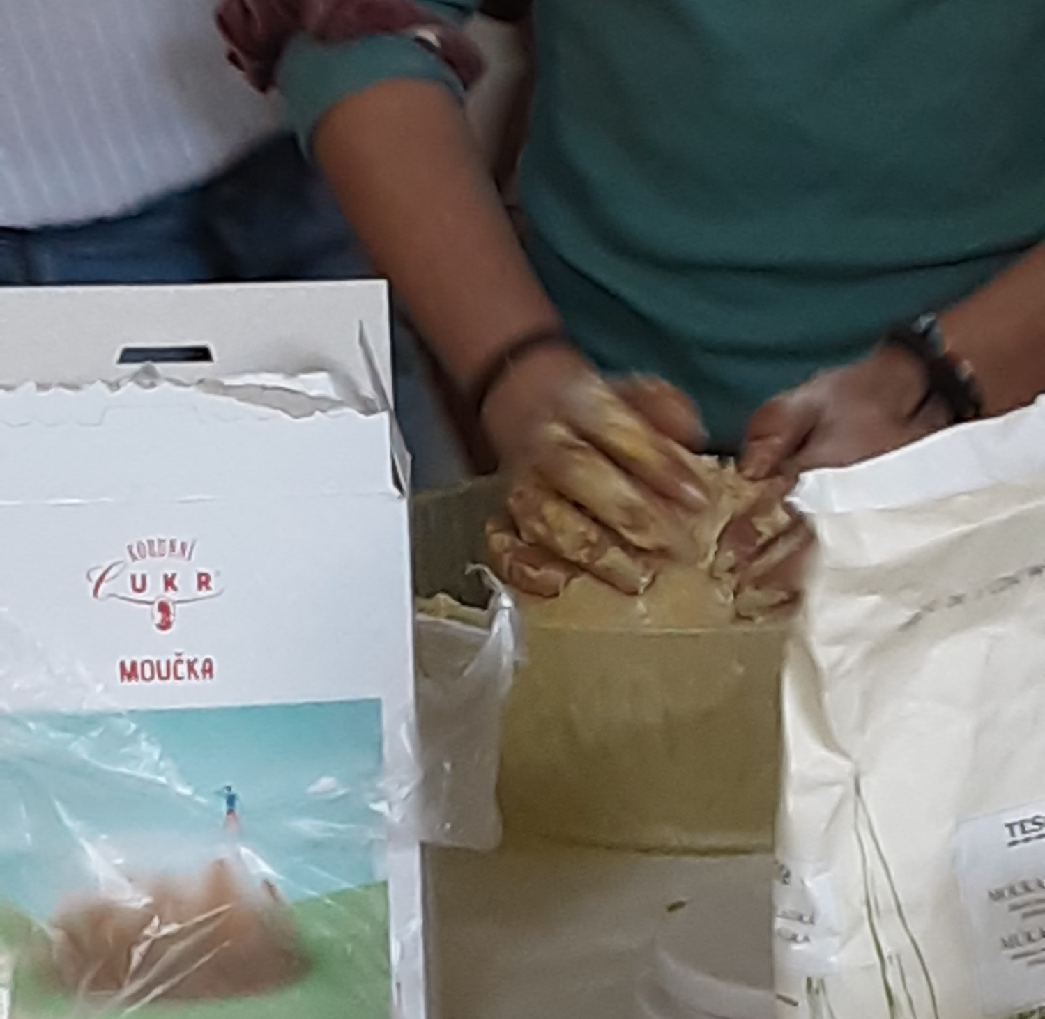
6. we sprinkled apples with cinnamon and vanilla sugar

Slide 9
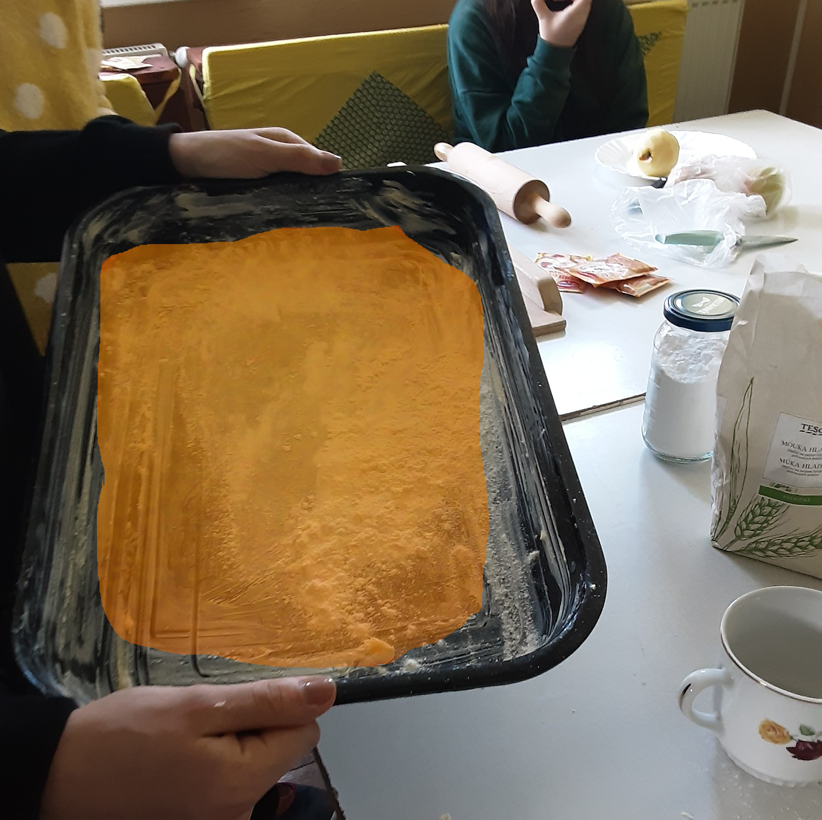
7. then we put the rolled dough on a baking sheet

Slide 10
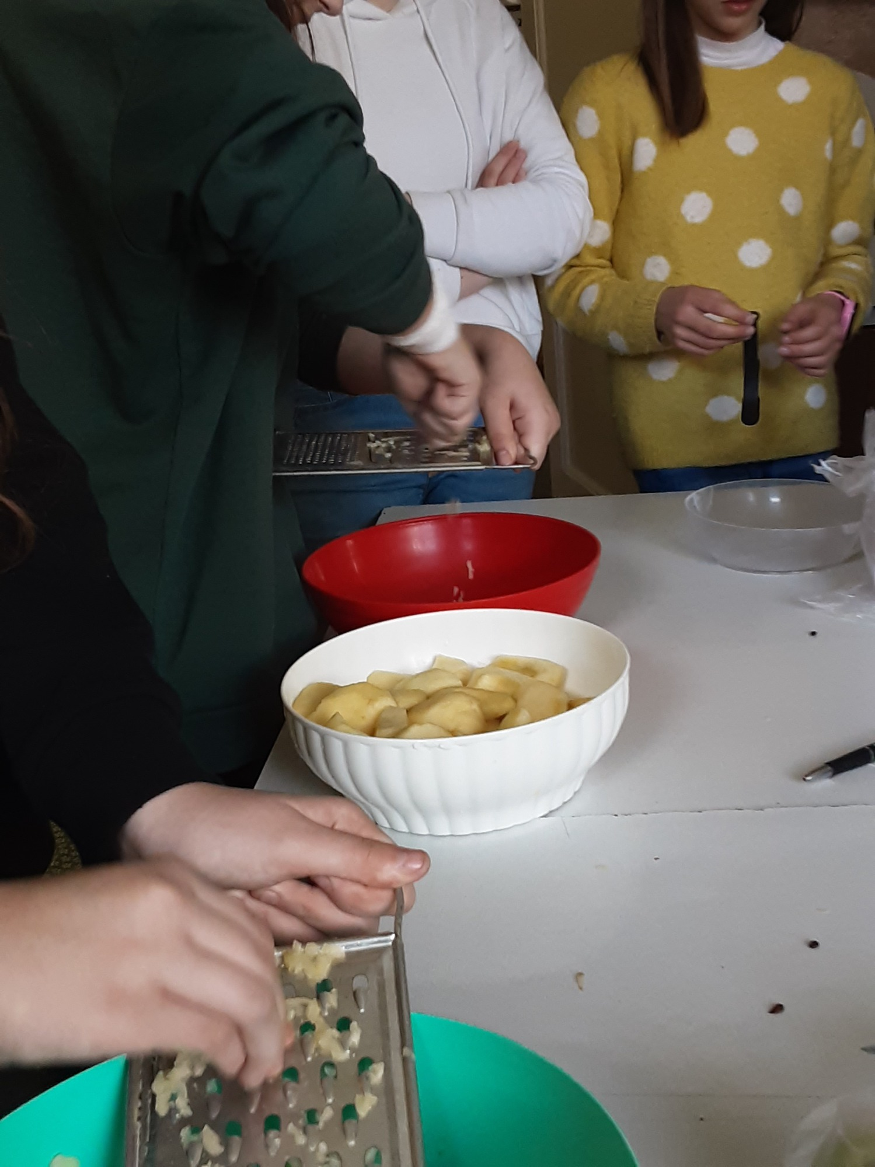
8. We squeezed the flavored apples and put them on a dough that was on a plate

Slide 11
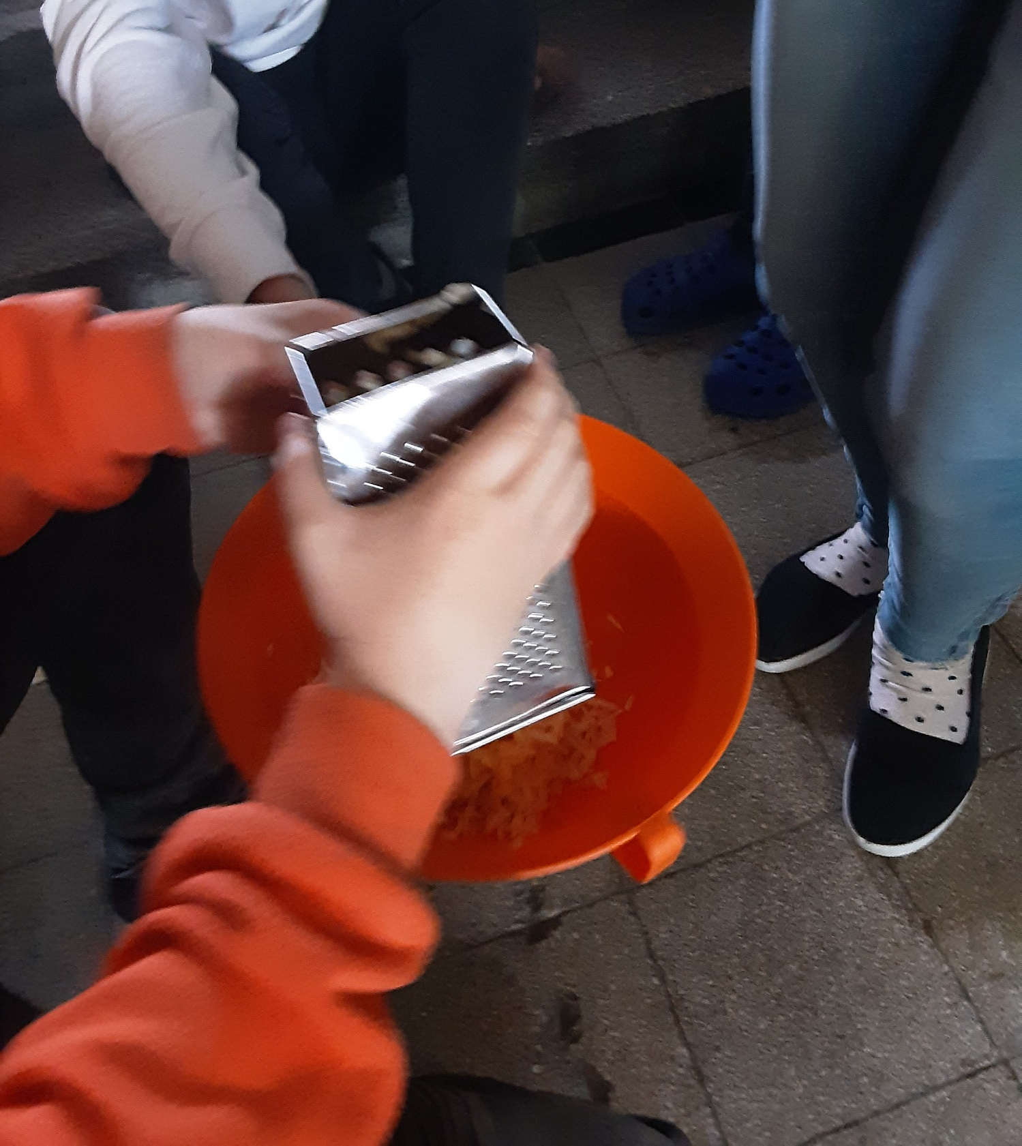
9. the other halfway we put on apples

Slide 12
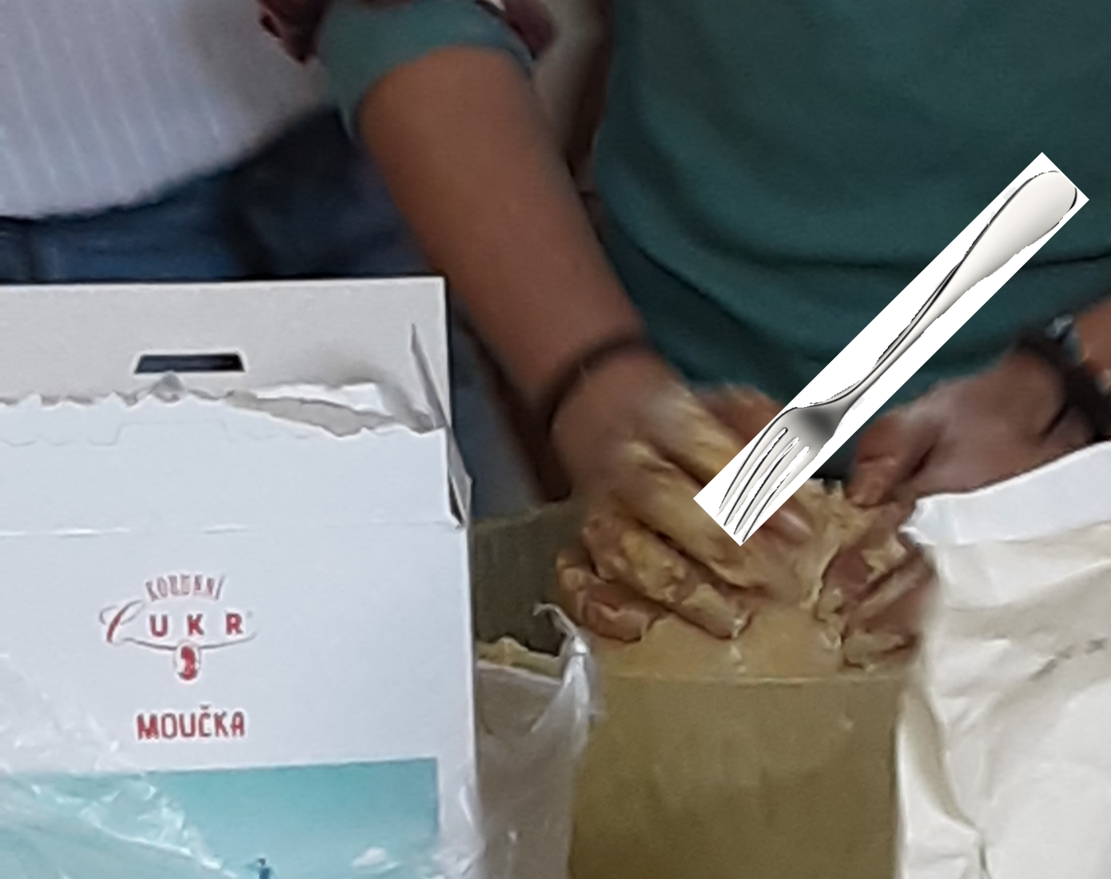
10. we stabbed the dough with a fork

Slide 13
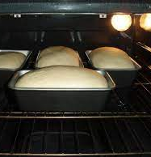
11. we put the dough in the oven

Slide 14
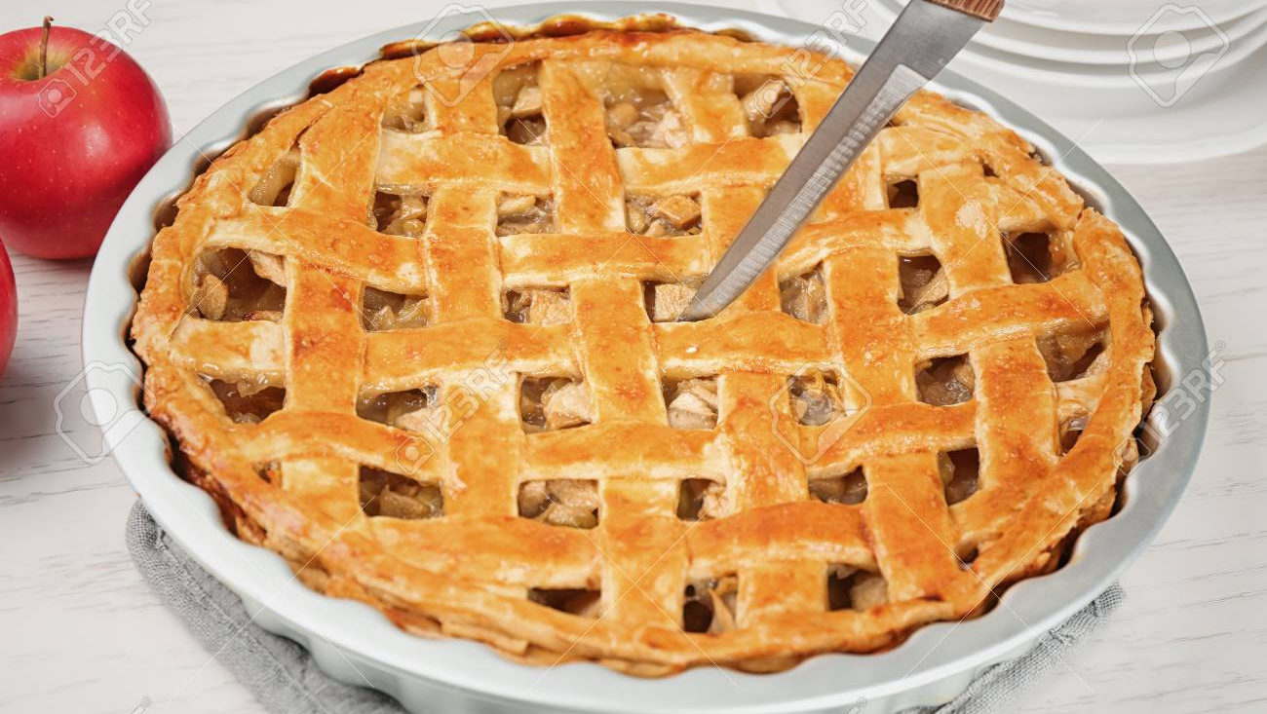
12. then we picked the dough and cut it

Slide 15
Thanks For Watching

